Slide 1
Lecture 10: BA Technologies
Prof. Mike Boyle
Department of Operations and Information Systems
University of Utah

Slide 2
Lecture Outline
Present example solutions for each of the major areas in modern BA Information Management platforms
  Objective: See/experience examples of the core BA technologies and solutions
Review highlights from the “Wisdom of Crowds Business Intelligence Market Study”
  Objective: Get a sense for the range of current BA vendors and technologies
  Objective: Understand recent trends in BA technology adoption
  Objective: Understand one framework that can be used to compare BA vendors and technologies

Slide 3
BA Technologies

Slide 4
BA Technologies
The BA Technologies chosen for presentation:
  Are not necessarily best-of-breed
  Are free/almost free and therefore accessible to students for experimentation
  Do not necessarily represent the entire range of technical features/solutions for the given area
There are many technology options for each area:
  For more technology options start with the “Wisdom of the Crowds Business Intelligence Market Study”

Slide 5
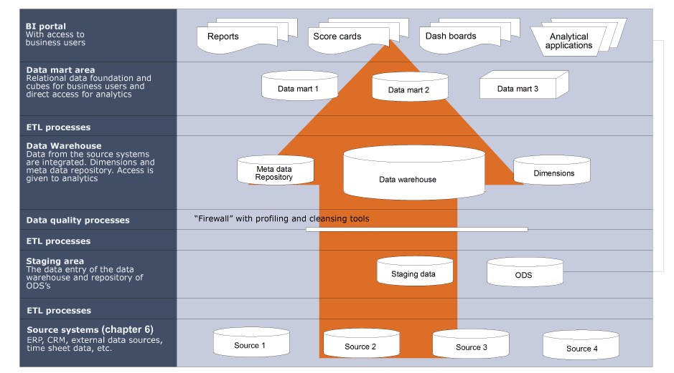
BA Technologies
Data Science/Analyst Tools

Slide 6
Source Systems
Business Applications:
  E.g. Customer Relationship Management (CRM)
    Zoho CRM
      http://crm.zoho.com
Data Feeds:
  E.g. JSON data feed
    Weather Underground Example
      http://api.wunderground.com/api/<your_key>/conditions/q/CA/San_Francisco.json

Slide 7
BA Technologies
Data Science/Analyst Tools

Slide 8
ETL Processes and Data Quality/Enrichment
Data Integration/ETL
  Pentaho Kettle
    Tutorial: http://wiki.pentaho.com/display/EAI/Pentaho+Data+Integration+%28Kettle%29+Tutorial
Data Quality/Enrichment
  Melissa Data
    http://www.melissadata.com/data-quality-pentaho/index.htm

Slide 9
BA Technologies
Data Science/Analyst Tools

Slide 10
Staging Area
Storage/File Server
  Amazon S3
    http://aws.amazon.com/s3/
  HDFS (Hadoop)
  ext4 (Linux)
  NTFS, ReFS (Windows)
Database Management System
  Relational Database: MySQL Server
    Introduction: http://dev.mysql.com/tech-resources/articles/mysql_intro.html
  NoSQL Database: MongoDB
    Introduction: http://docs.mongodb.org/manual/tutorial/getting-started/
    When to use MongoDB rather than MySQL*
      High write rate favored over transactional integrity
      High availability in the cloud
      Massive data growth requirements (i.e. 5-10GB per table)
      Flexibility in data schema requried
* source: http://java.dzone.com/articles/when-use-mongodb-rather-mysql, accessed 2014/10/14

Slide 11
BA Technologies
Data Science/Analyst Tools

Slide 12
Data Warehouse and Data Mart Area
Database Management System
  Relational Database: MySQL Server
  Analytic (Columnar) Database: Infobright Server
    Introductory videos: http://www.youtube.com/playlist?list=PL398E773DBDCD7D5A&feature=viewall
OLAP Cube Meta Data Development/Publishing
  Pentaho Schema Workbench
    Documentation: http://mondrian.pentaho.com/documentation/workbench.php
Report Development/Publishing
  Pentaho Report Designer
    Quick Start: http://wiki.pentaho.com/display/Reporting/1.+Quick+Start

Slide 13
BA Technologies
Data Science/Analyst Tools

Slide 14
BI Portal
Business Intelligence Server
  Pentaho BI Server and Pentaho Administrative Console
    Introduction:
      http://wiki.pentaho.com/display/ServerDoc2x/Introduction+to+the+BI+Platform

Slide 15
BA Technologies
Data Science/Analyst Tools

Slide 16
Data Science/Analyst Tools
General Analysis:
  Excel
Data Visualization:
  Tableau
    Training Material: http://www.tableausoftware.com/learn/training
Advanced Analysis (e.g. statistical analysis, data mining, optimization):
  R
    Resources: http://www.statmethods.net/

Slide 17
Data Science/Analyst Tools (cont’d)
Database Client:
  MySQL Workbench
    Getting Started: http://dev.mysql.com/doc/workbench/en/wb-getting-started-tutorial.html
Scripting: Data preparation and automation
  Python
    Tutorials: http://learnpythonthehardway.org/book/

Slide 18
Business Intelligence Market Study
“Wisdom of the Crowds Business Intelligence Market Study”

Slide 19
Wisdom of Crowds (WoC) BI Market Study*
Executive Summary:
  Executive Management is both the chief driver behind Business Intelligence initiatives and the primary consumer/beneficiary.
    IT, Strategic Planning and BI Competency functions play an increasing role with size of company.
  “Better decision making” is the most popular objective for Business Intelligence solutions, across all market sectors.
    “Improved operational efficiency” was the second most common objective.
  User penetration of Business Intelligence solutions remains modest, with 36% of respondents reporting less than 10% of users with access to BI today.
  Perceived success remained largely unchanged over 2012, with a majority of respondents reporting some measure of success with Business Intelligence.
    Those reporting greater success were likely to have more ambitious deployment plans and fewer redundant tools.
* Wisdom of Crowds Business Intelligence Market Study, 2013 Edition

Slide 20
Wisdom of Crowds (WoC) BI Market Study*
Executive Summary (cont’d):
  Success with Business Intelligence has more to do with management support and ownership, organizational stability, a focus upon critical opportunities and requisite skills - than technology.
    Although, once those elements are in place, excellent technology is an important enabler.
  Top technology priorities related to BI for 2013 include: Dashboards, End user “self service”, Advanced visualization and Data Warehousing.
    The only ones to increase in priority over 2012 were Cloud BI, Dashboards and Mobile BI.
  Smaller organizations were more likely to place a priority upon Mobile BI and Cloud BI, while large organizations favored Data Warehousing and Data Mining.
  From an industry perspective respondents gave vendors higher overall scores for all categories of measurement, including: Sales, Value, Product, Technical support, Consulting, Integrity and Recommended.
* Wisdom of Crowds Business Intelligence Market Study, 2013 Edition

Slide 21
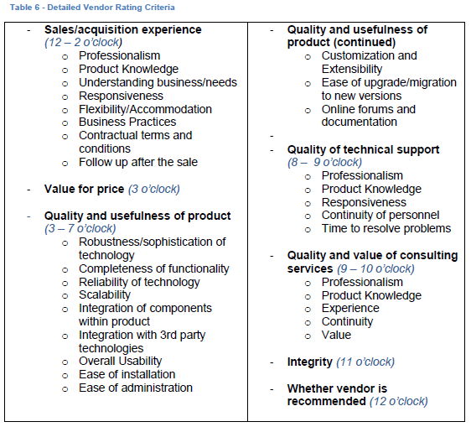
Wisdom of Crowds (WoC) BI Market Study* (cont’d)
Vendor Analysis Rating Criteria:
  33 criteria in 8 categories
* Wisdom of Crowds Business Intelligence Market Study, 2013 Edition

Slide 22
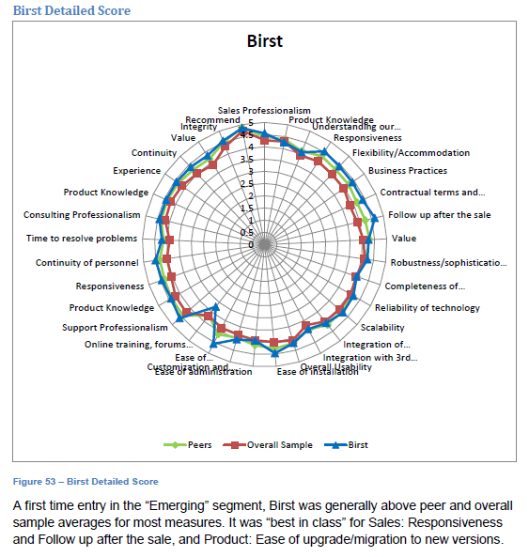
Wisdom of Crowds (WoC) BI Market Study* (cont’d)
Birst
  Note: in “Emerging” segment
* Wisdom of Crowds Business Intelligence Market Study, 2013 Edition

Slide 23
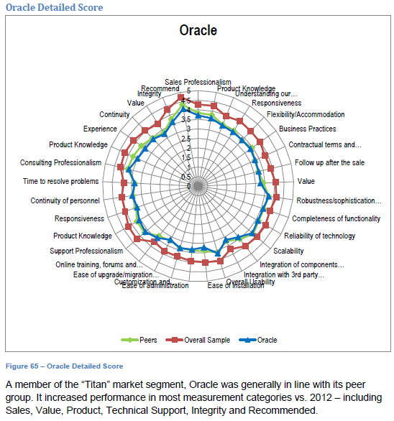
Wisdom of Crowds (WoC) BI Market Study* (cont’d)
Oracle
  Note: in “Titan” segment
* Wisdom of Crowds Business Intelligence Market Study, 2013 Edition

Slide 24
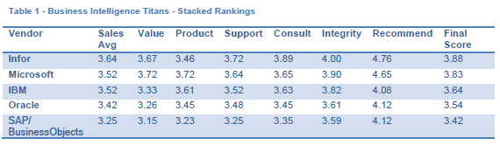
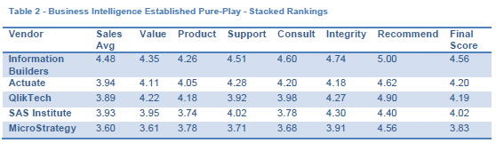
Wisdom of Crowds (WoC) BI Market Study* (cont’d)
Summary Results:
* Wisdom of Crowds Business Intelligence Market Study, 2013 Edition

Slide 25
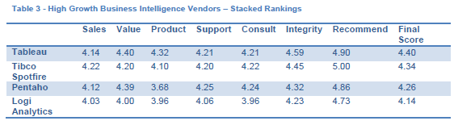
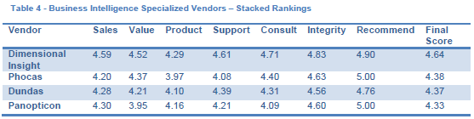
Wisdom of Crowds (WoC) BI Market Study* (cont’d)
Summary Results (cont’d):
* Wisdom of Crowds Business Intelligence Market Study, 2013 Edition

Slide 26
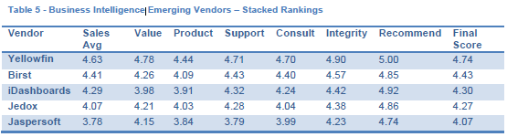
Wisdom of Crowds (WoC) BI Market Study* (cont’d)
Summary Results (cont’d):

Slide 27
Appendix

